Slide 1

Data-Driven Insights for Jensen’s
SUBMITTED BY : HIMANI GAUTAM

Slide 2

Problem Statements :
Find the total number of products sold by each store along with the store name.
Calculate the cumulative sum of quantities sold for each product over time.
Find the product with the highest total sales (quantity * price) for each category.
Find the customer who spent the most money on orders.
Find the highest-priced product for each category name.
Find the total number of orders placed by each customer per store.
Find the names of staff members who have not made any sales.
Find the top 3 most sold products in terms of quantity.
Find the median value of the price list.
List all products that have never been ordered.(use Exists)
List the names of staff members who have made more sales than the average number of sales by all staff members.
Identify the customers who have ordered all types of products (i.e., from every category).

Slide 3
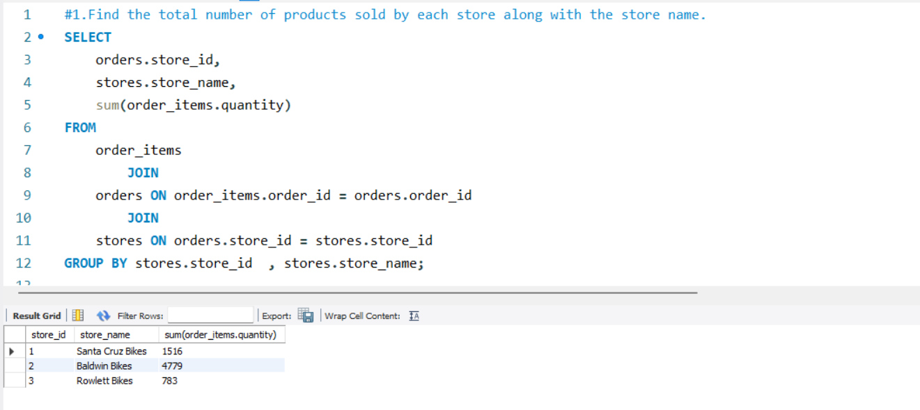
1. Find the total number of products sold by each store along with the store name.

Slide 4
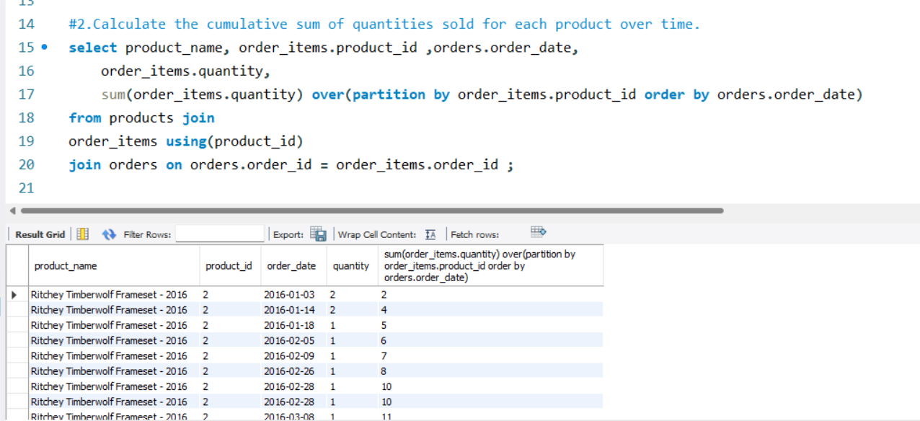
2. Calculate the cumulative sum of quantities sold for each product over time.

Slide 5
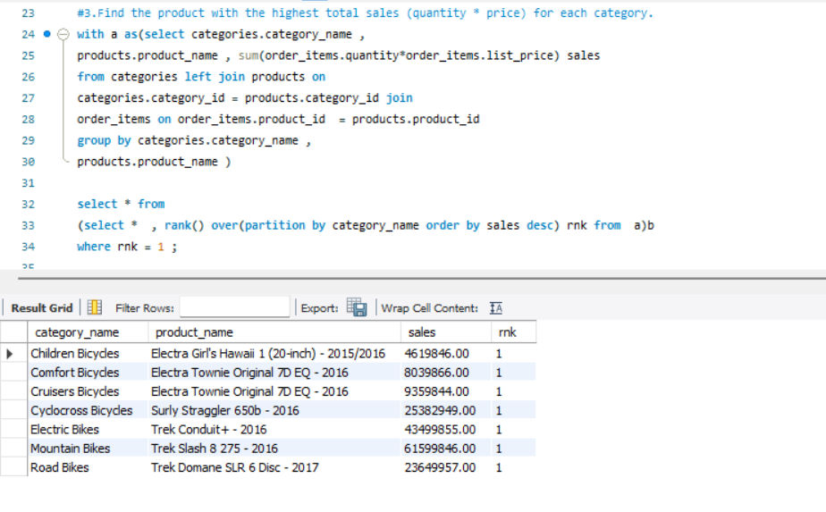
3.Find the product with the highest total sales (quantity * price) for each category.

Slide 6
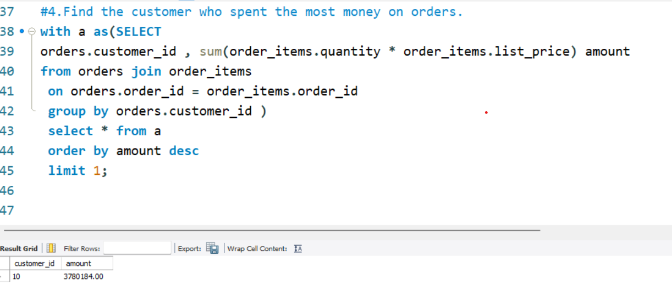
4. Find the customer who spent the most money on orders.

Slide 7
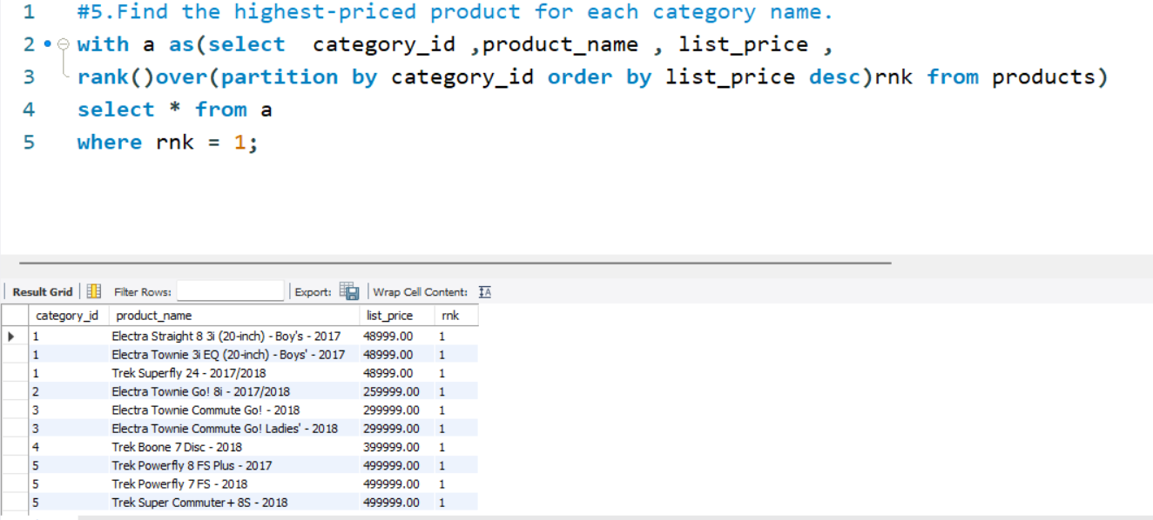
5. Find the highest-priced product for each category name.

Slide 8
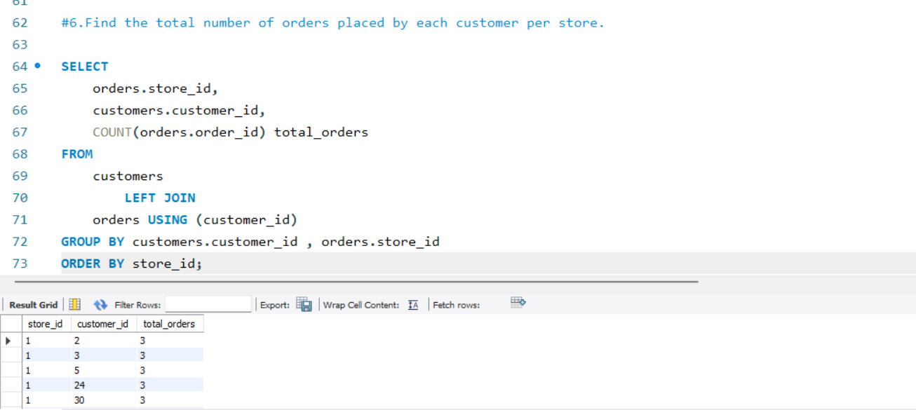
6. Find the total number of orders placed by each customer per store.

Slide 9
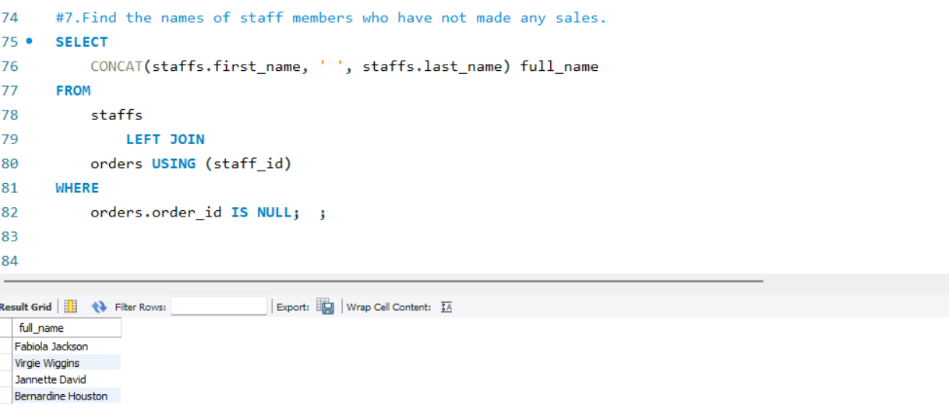
7. Find the names of staff members who have not made any sales.

Slide 10
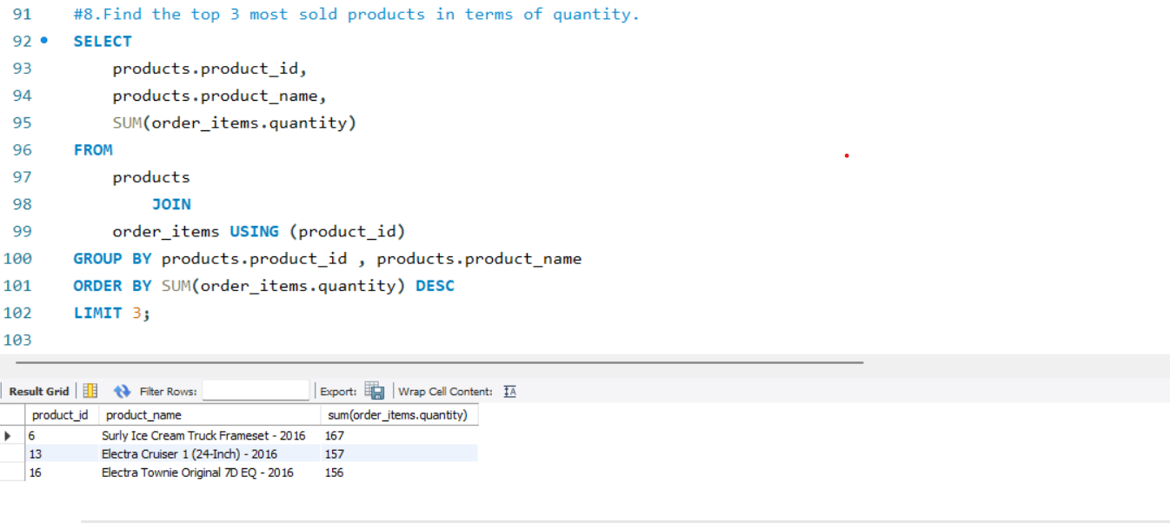
8. Find the top 3 most sold products in terms of quantity

Slide 11
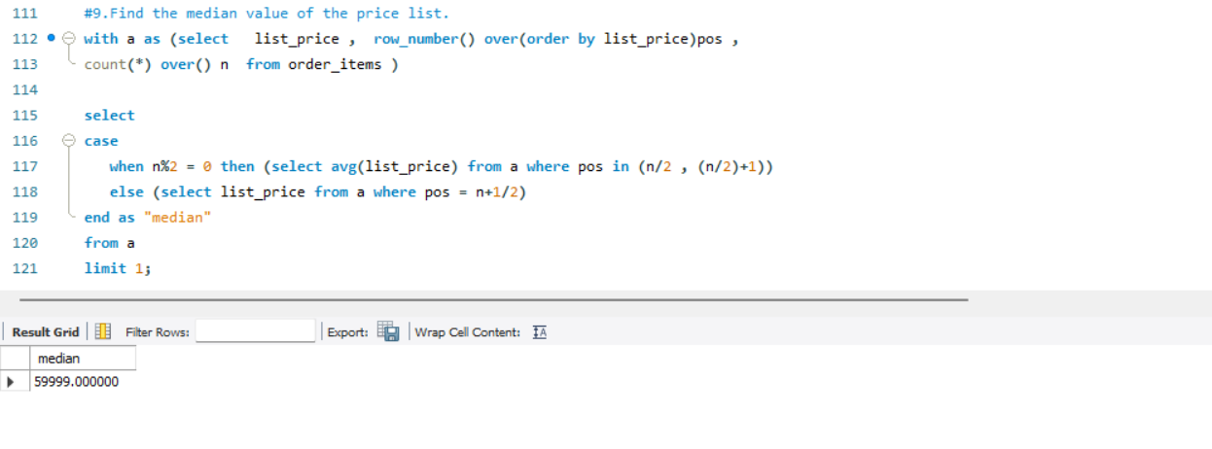
9. Find the median value of the price list.

Slide 12
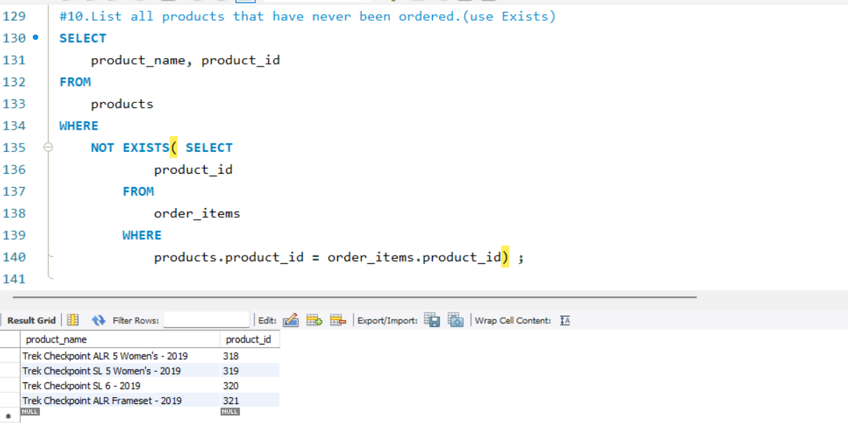
10. List all products that have never been ordered.(use Exists)

Slide 13
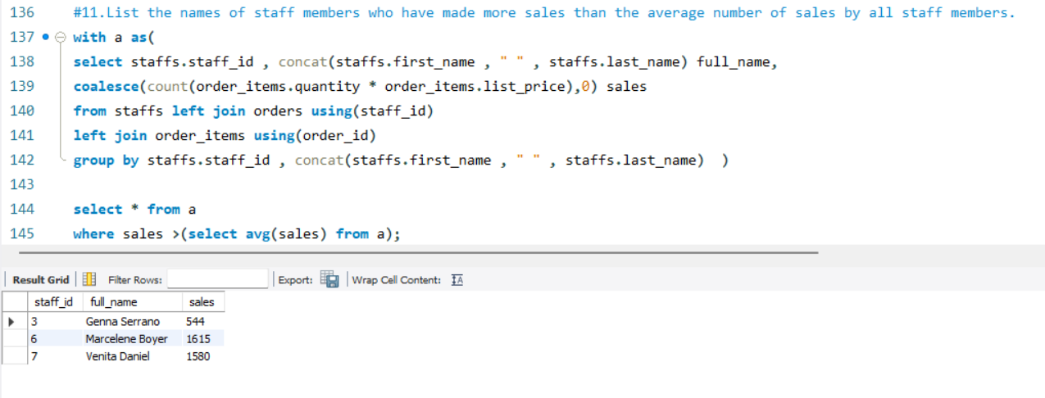
11.List the names of staff members who have made more sales than the average number of sales by all staff members.

Slide 14
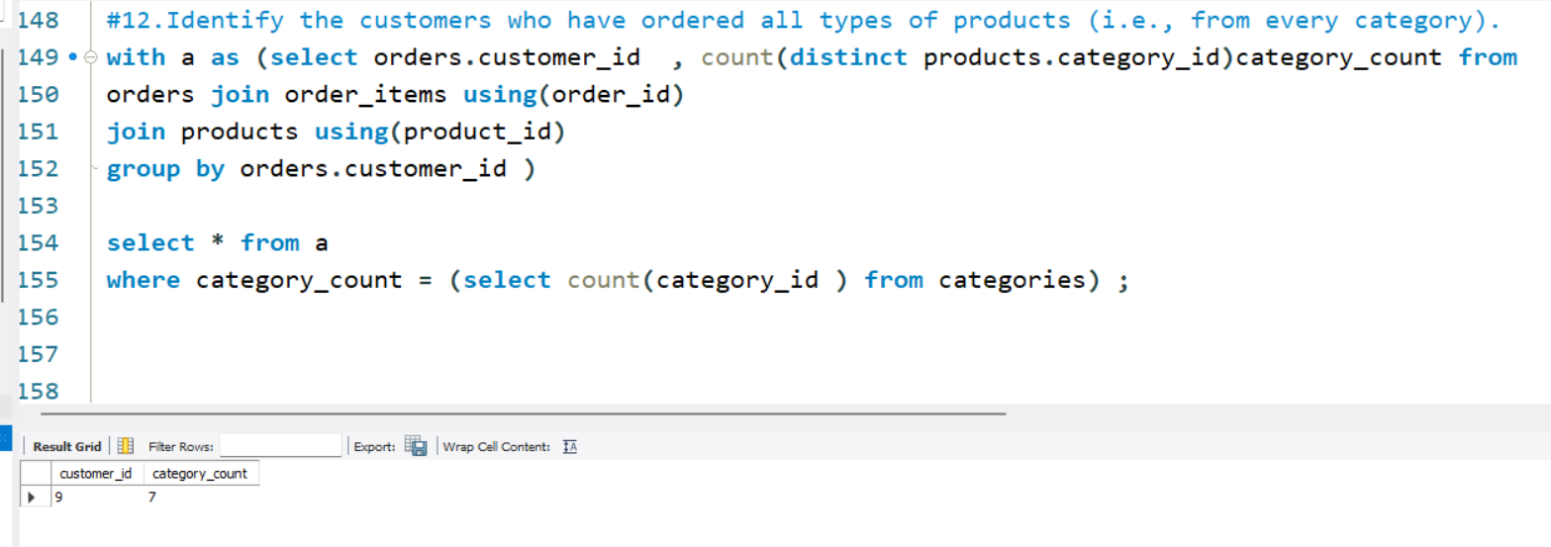
12. Identify the customers who have ordered all types of products (i.e., from every category).

Slide 15
Key Insights:
🏪 Store-wise Sales: Stores differ in total product sales — can guide inventory allocation.
🧾 Top-Spending Customers: High-value customers identified — potential for loyalty programs.
📦 Category Stars: Top products by sales revenue vary across categories — scope for targeted promotions.
🛒 Zero-Order Products: Several products never ordered — opportunity to investigate pricing or demand.
👨‍💼 Staff Performance: Some staff outperform, while others made no sales — use for training or optimization.
🏷 Pricing Distribution: Median price value calculated — helpful for pricing strategy benchmarking.

